Slide 1
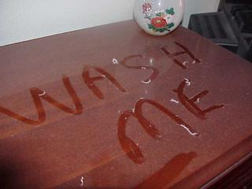
Project on theme:
«Be careful: dust!»
The work is made
by pupils of the 8th
form of
Plotnikovskaja
school
Semgaikina Karina
and Rjabuchina
Alina
Instructors of the
project are Kurkina S.A
and Tjantova O.M

Slide 2
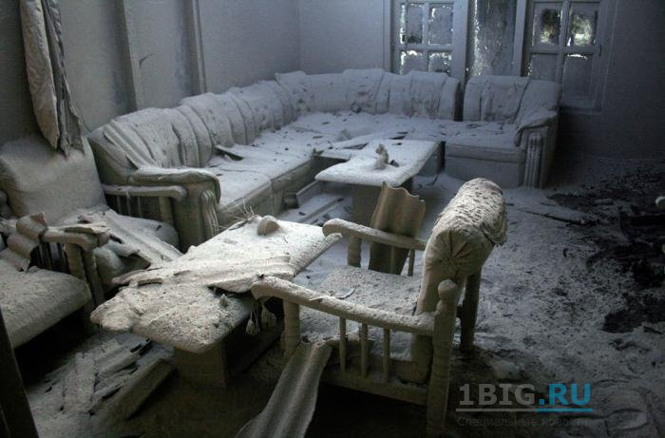
Ancient Greek doctor Hippocrates said, that disease appears because of our way of life and because of air, which we breathe

Slide 3
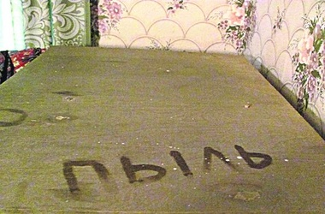
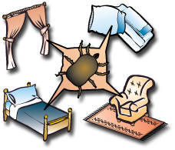
The aim: to explore structure of “street’s” and “domestic” dust and their influence on pupils’ health

Slide 4
Objects of the project
To consider the definition “dust” and its classification
clear up reasons of dust’s formation;
Question pupils of Plotnikovskaja school about knowledge of dust’s harm and importance to change shoes;
Get to know how dusty are the classrooms and house roomsо by means of tape and cotton discs;
Expose degree of danger how dust influence on people’s organism;
offer some steps to lessen dust in the air;
Work out and hold out- of- school arrangement

Slide 5
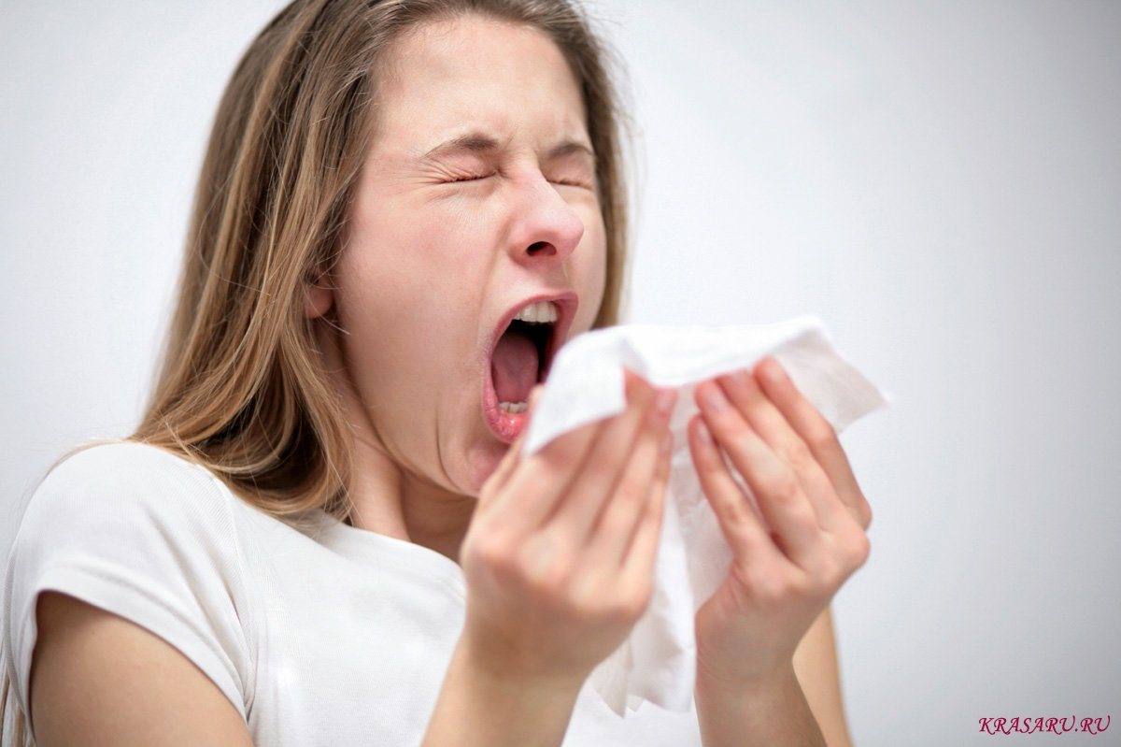
As it turned out, 4 pupils in our school have allergy

Slide 6
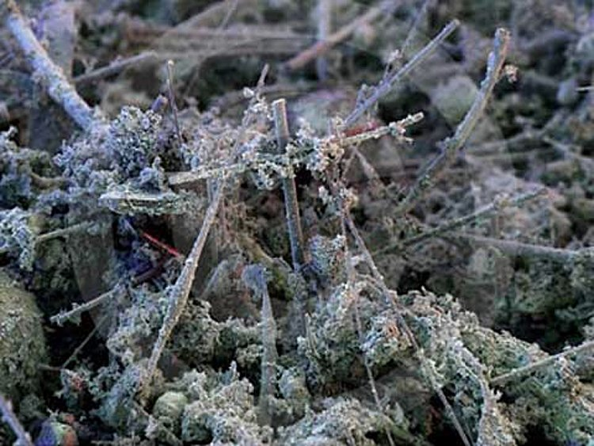
Dust consists of particles in the atmosphere that come from various sources such as soil, dust lifted by weather

Slide 7
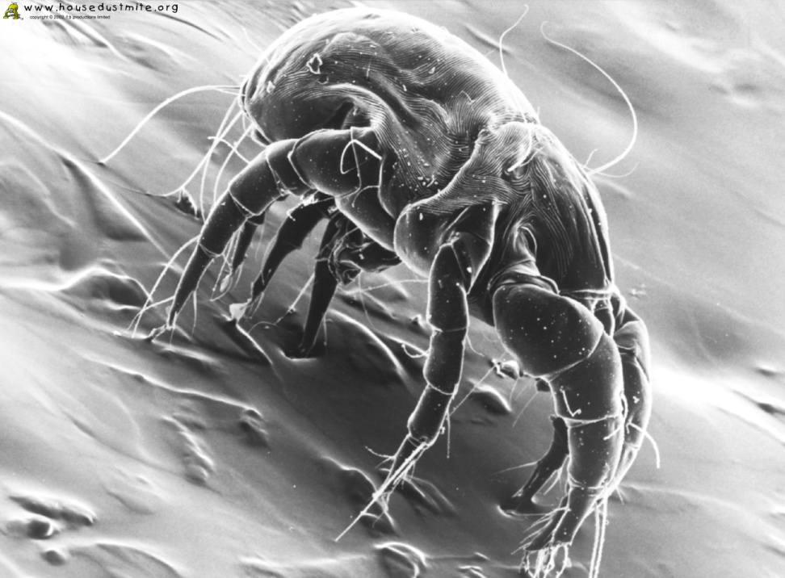
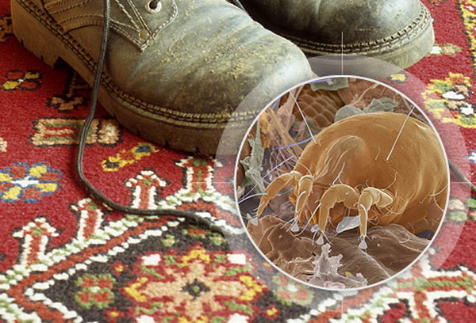
Both “domestic” and “street’s” dust are very dangerous for health

Slide 8
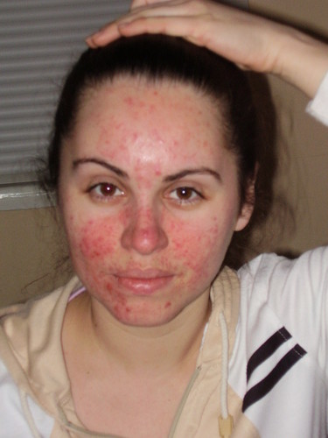
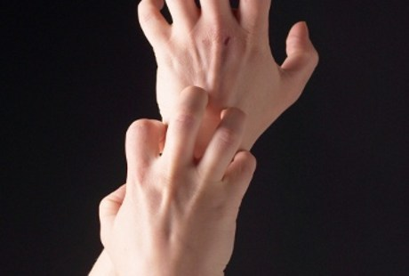
Harm for skin- itch, dryness, abscesses

Slide 9
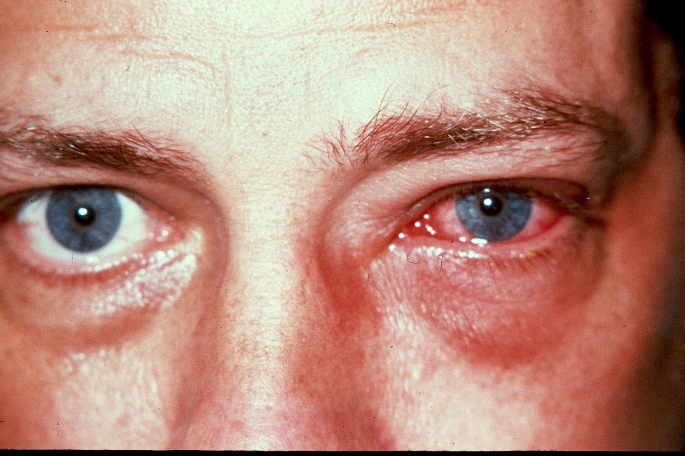
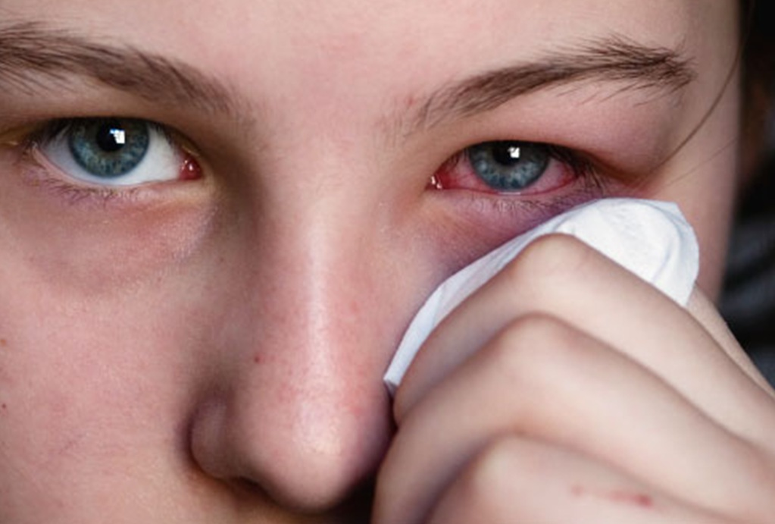
Harm for eyes -conjunctivitis

Slide 10
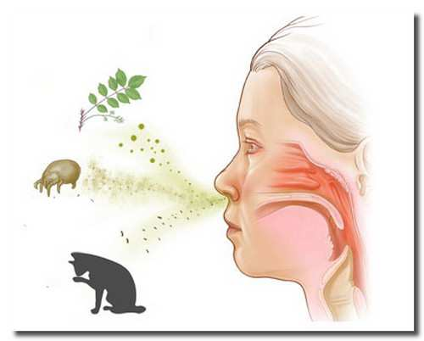
Harm for respiratory tracts-allergic rhinitis, asthma

Slide 11
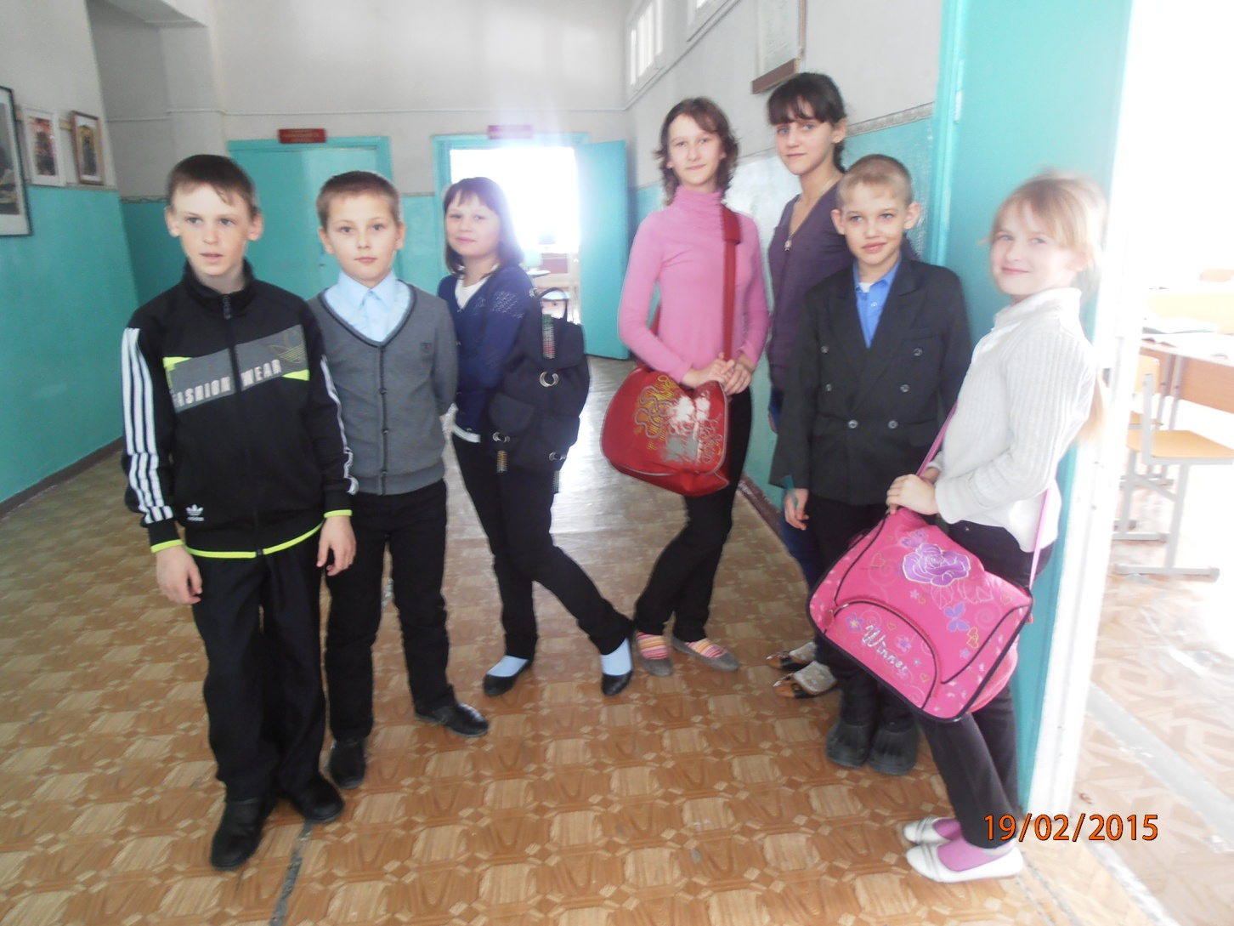
One of the reasons why dust appear in the school- children don’t take second shoes

Slide 12
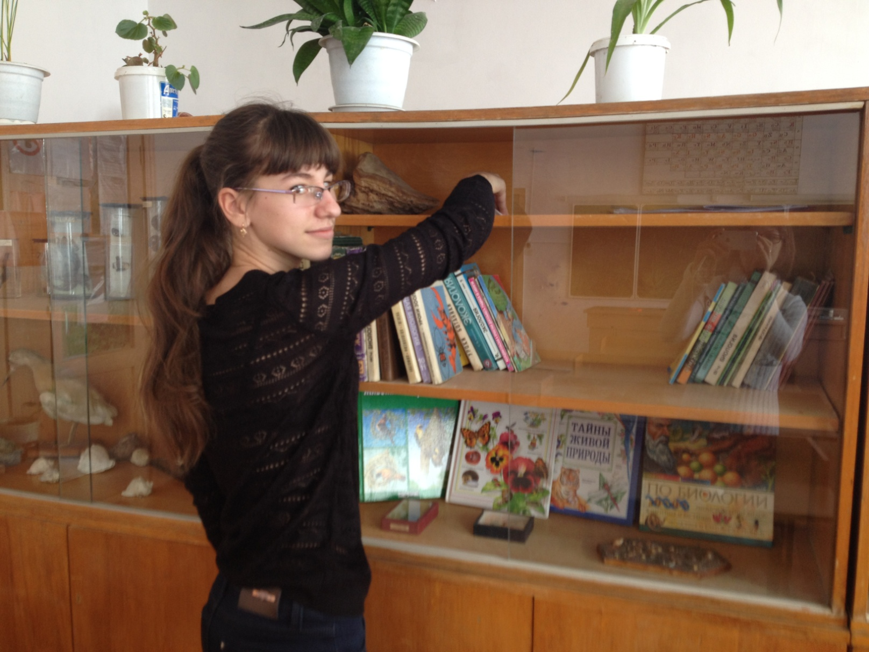
Steps of work on the project

Slide 13
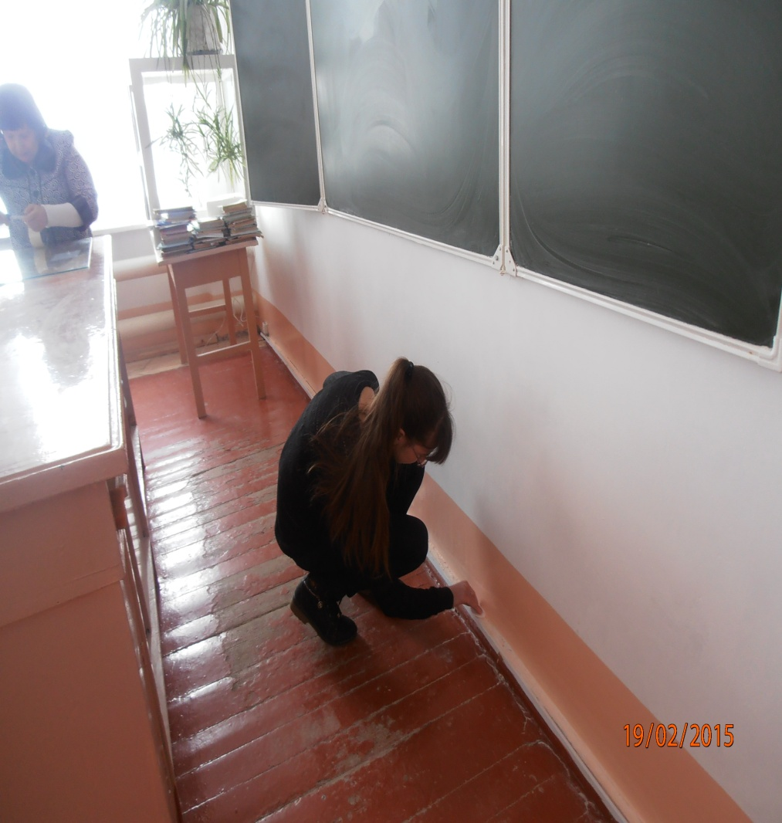
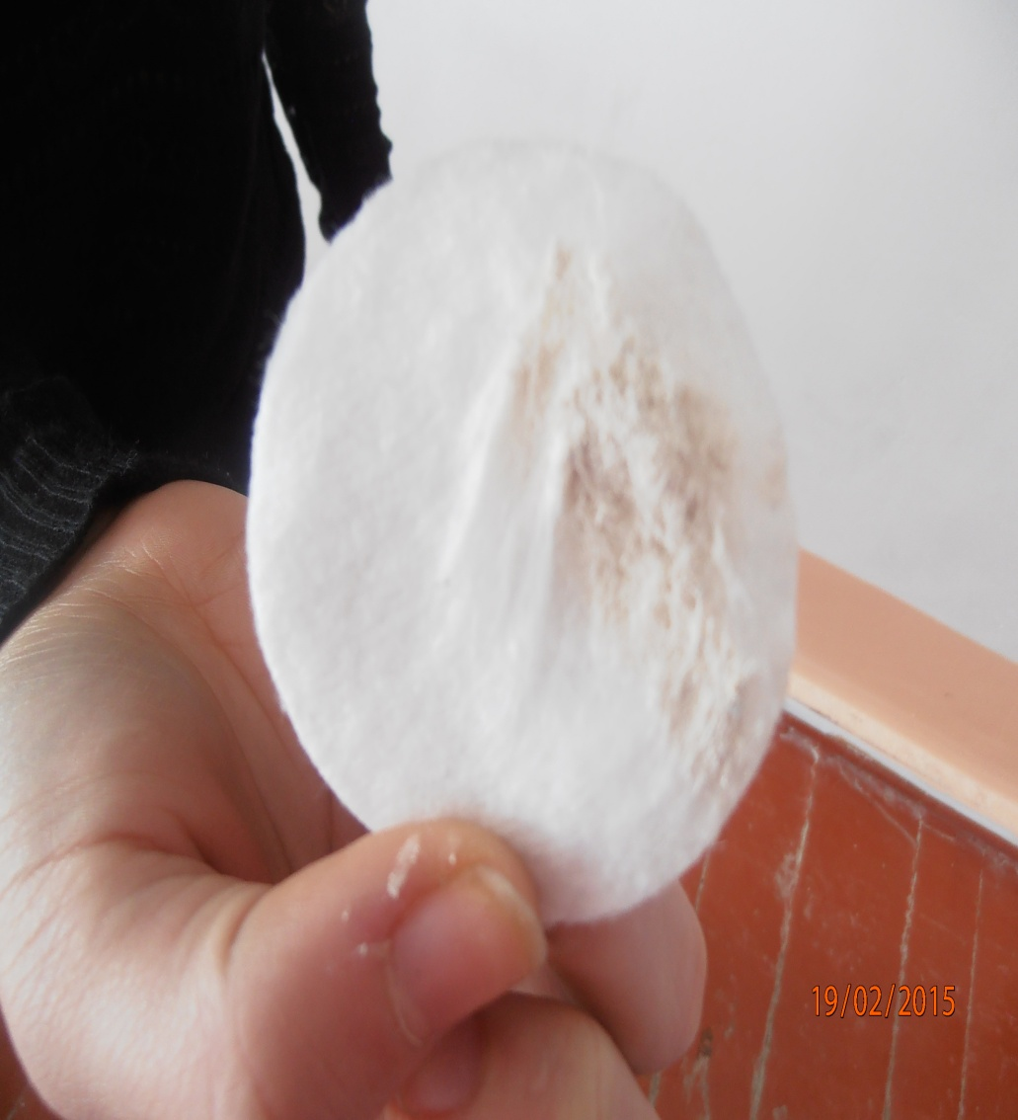
Collect dust in Biology classroom

Slide 14
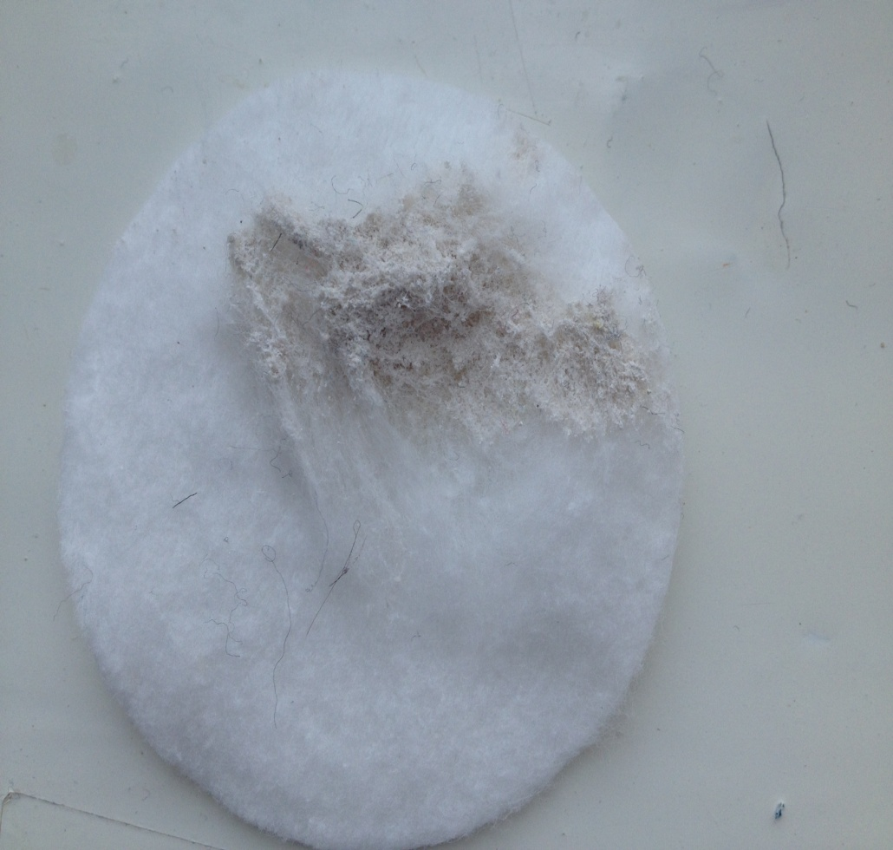
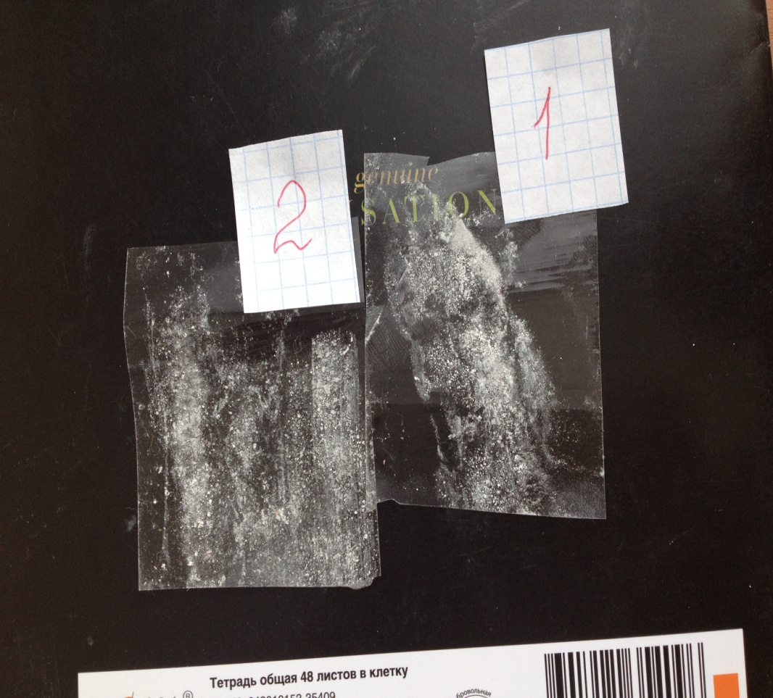
Dust is carbonate origin

Slide 15
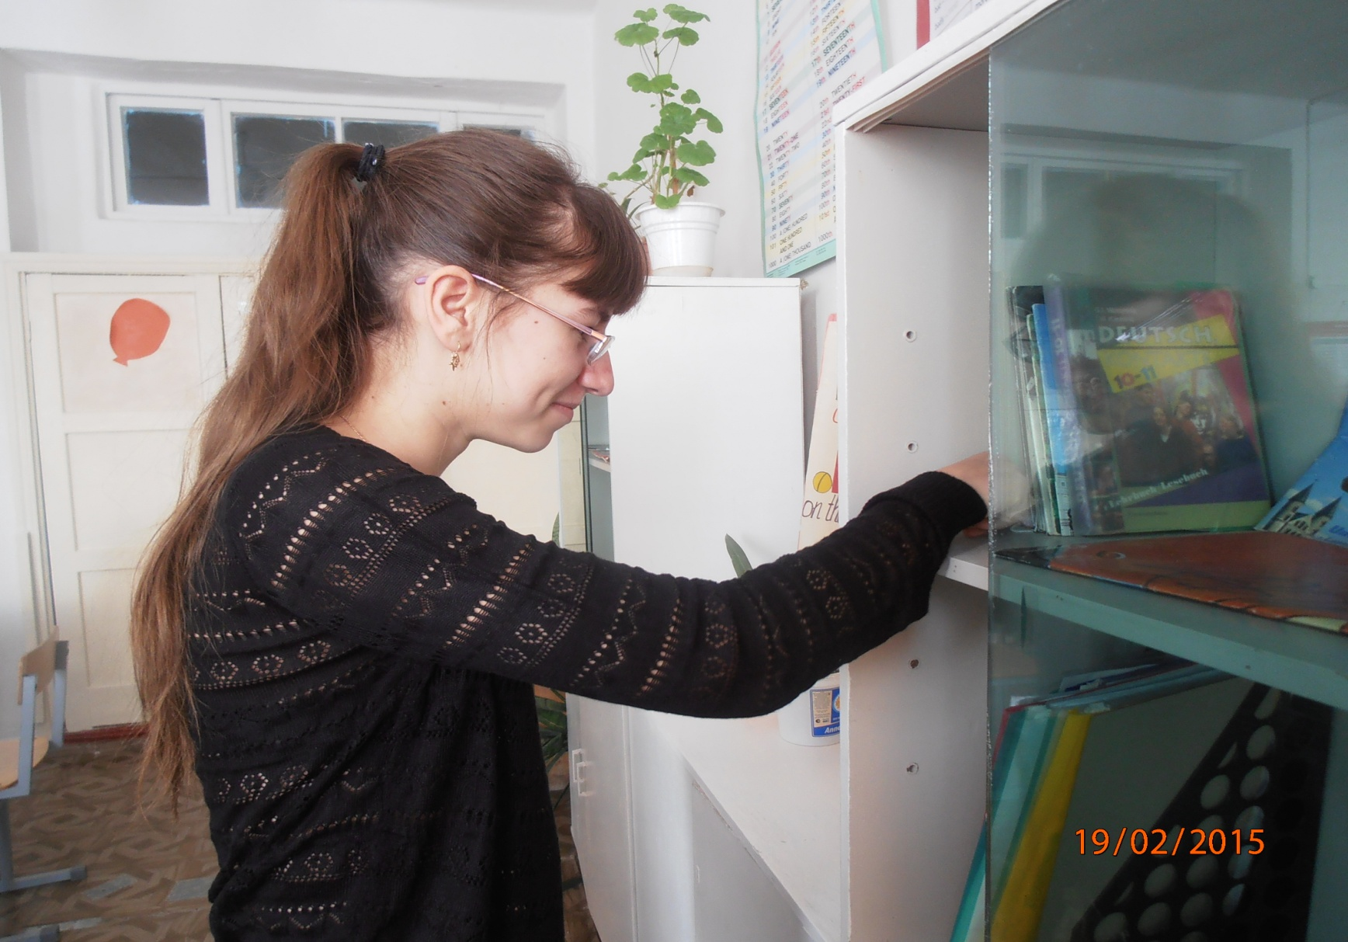
How much dust is in English classroom?

Slide 16
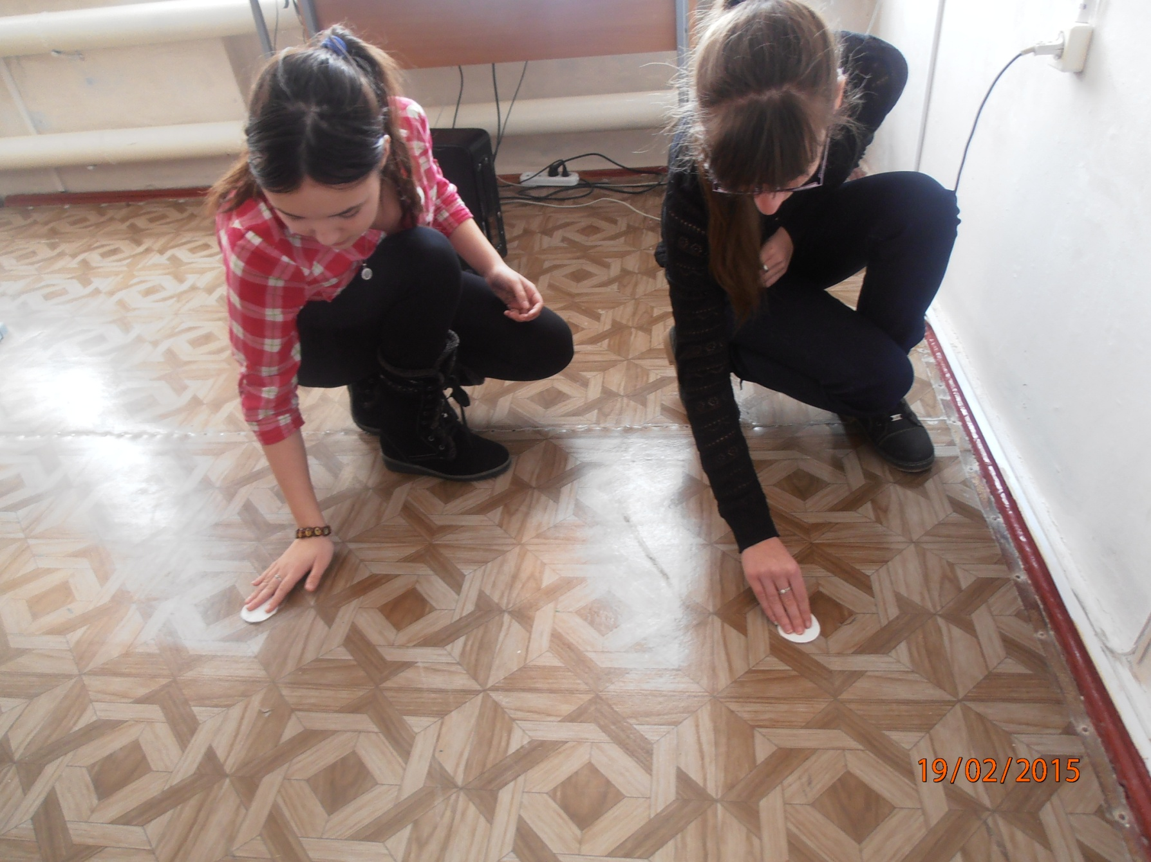

Slide 17
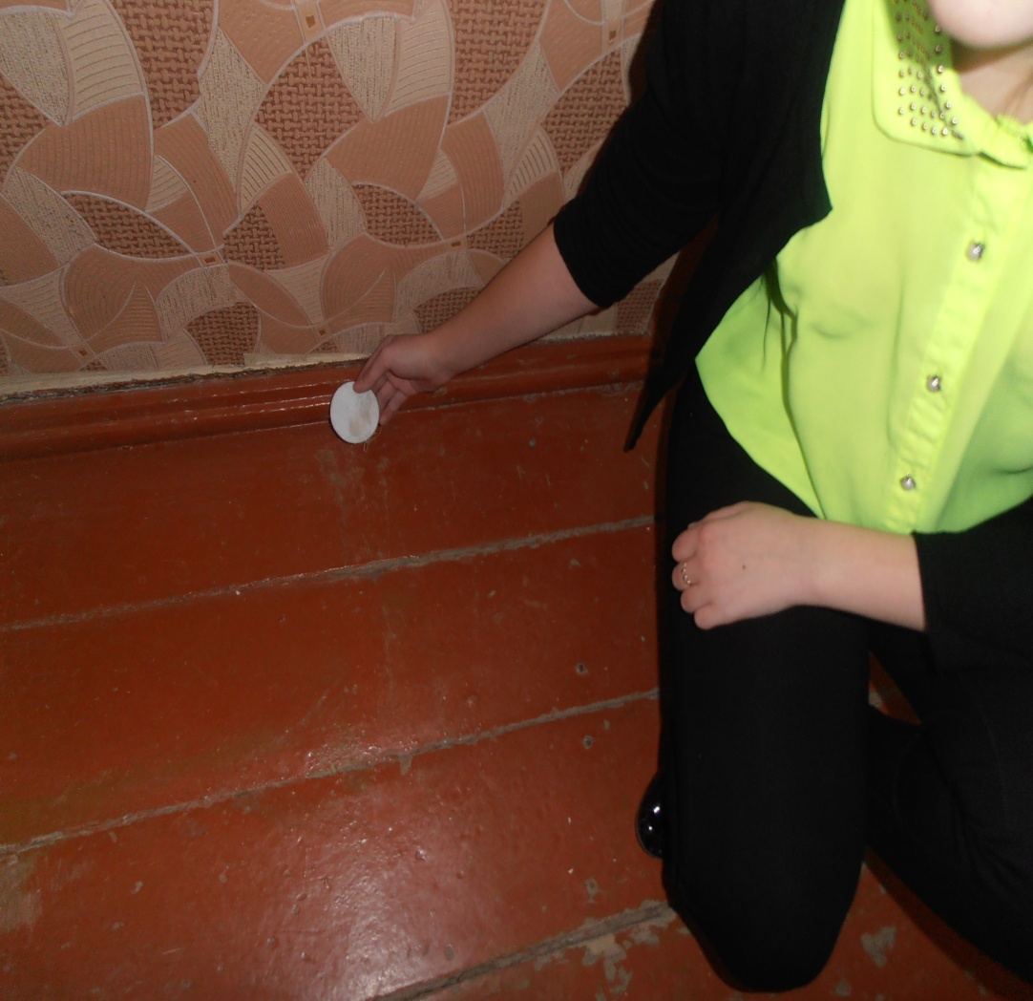
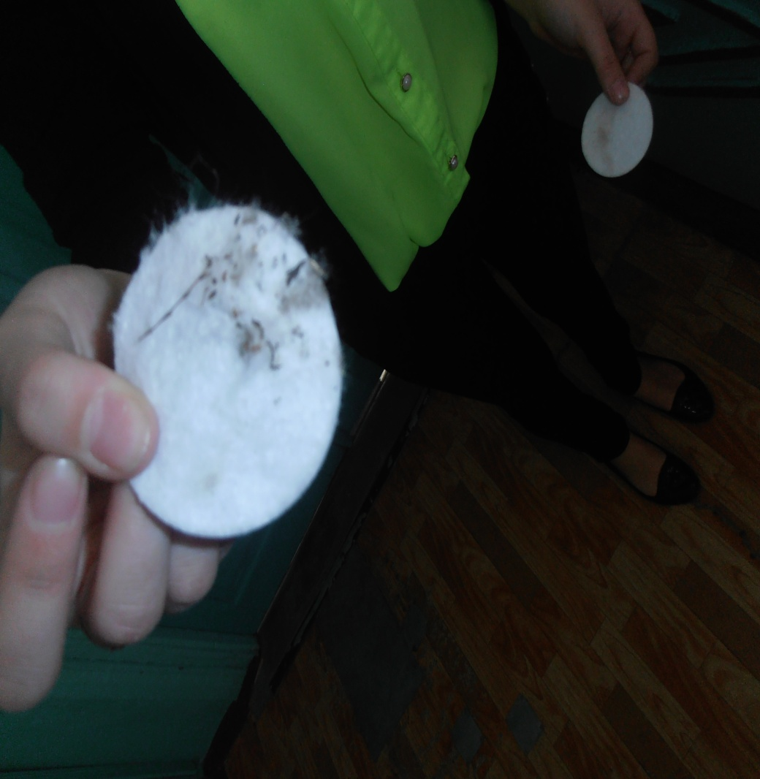
Collection dust in Technology classroom

Slide 18
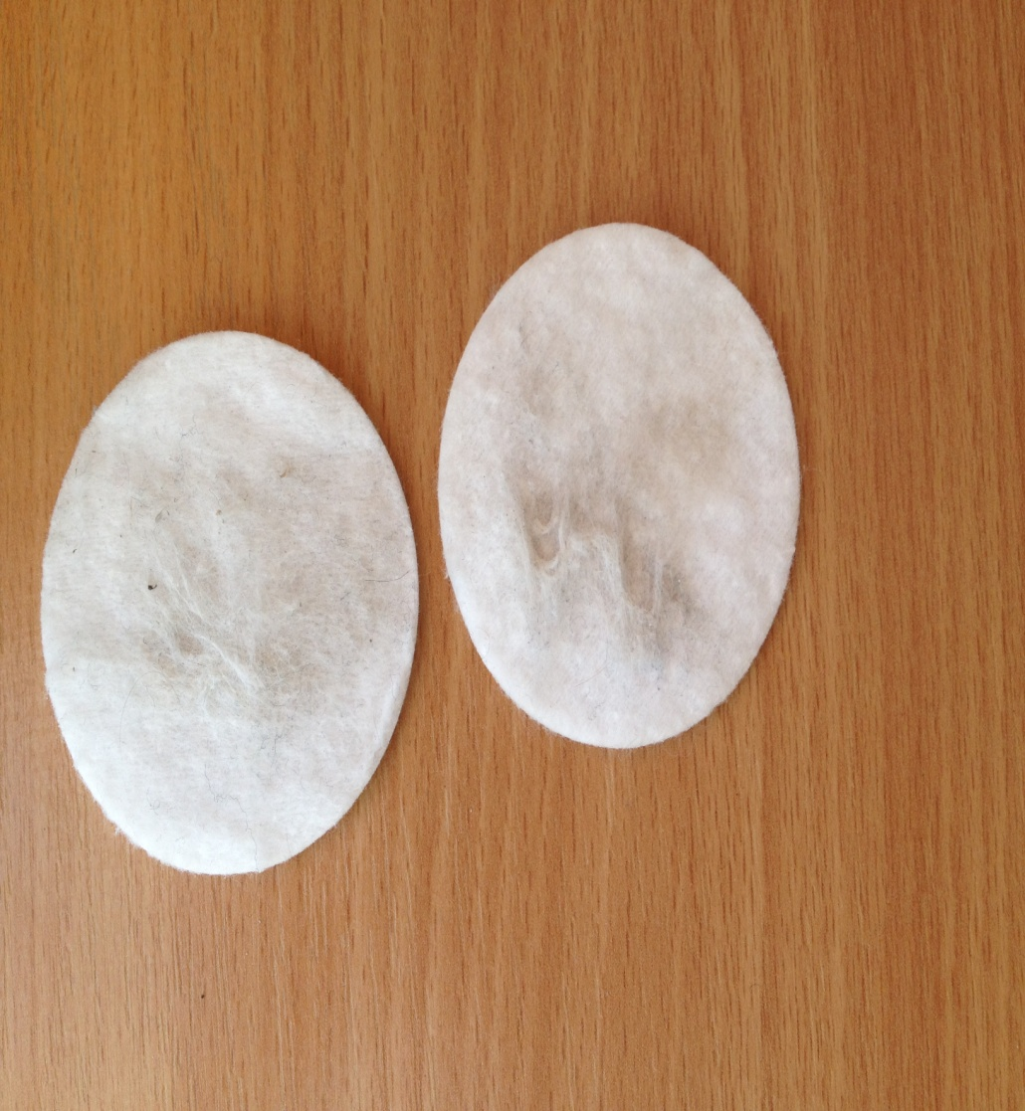
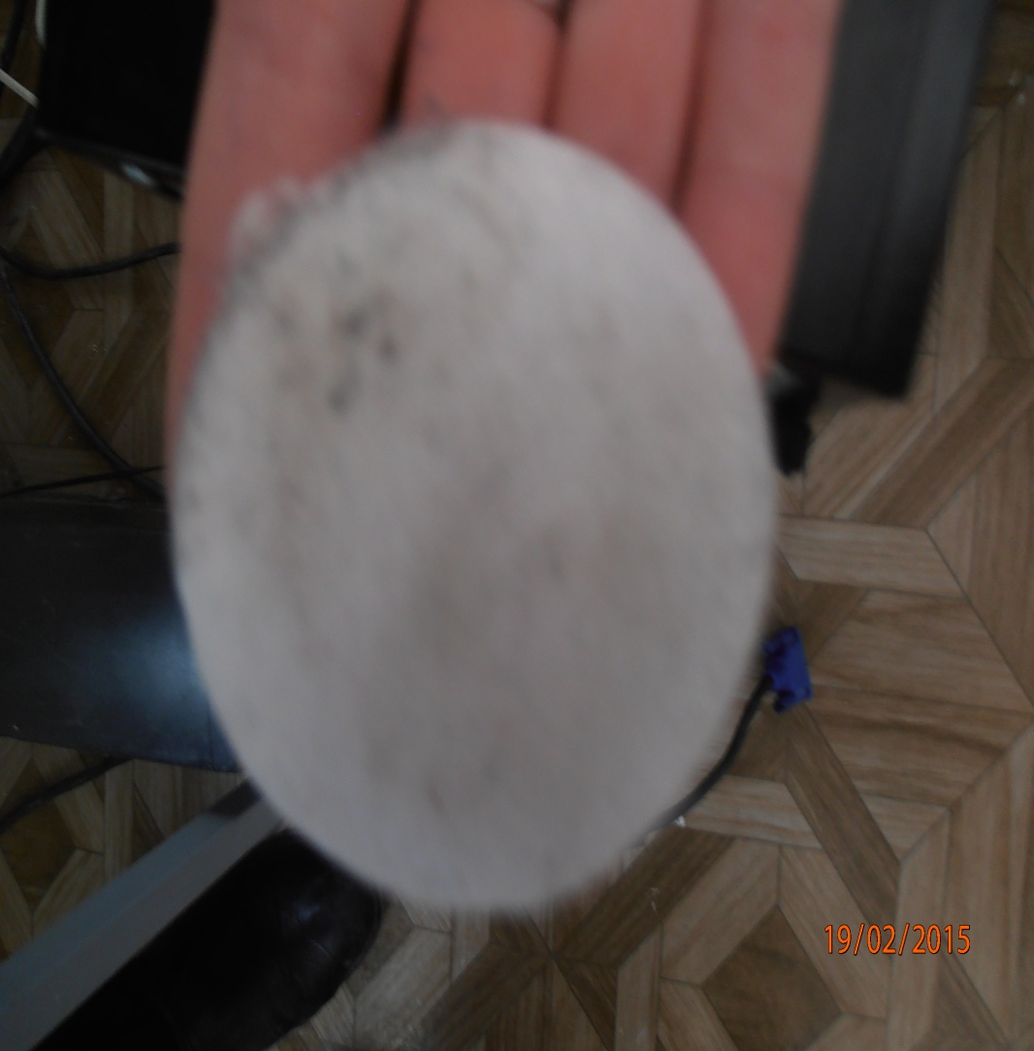

Slide 19
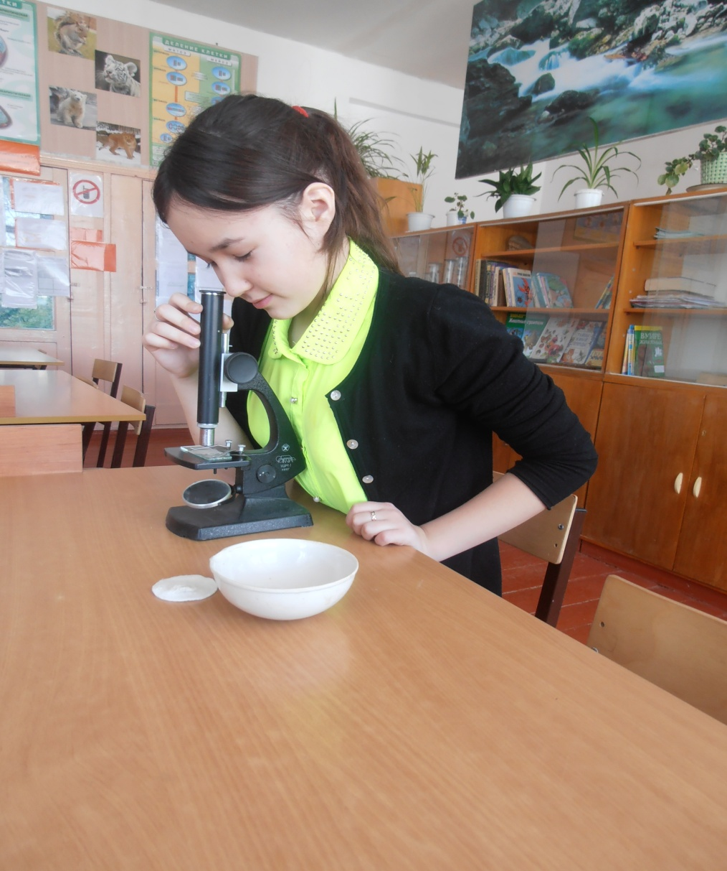
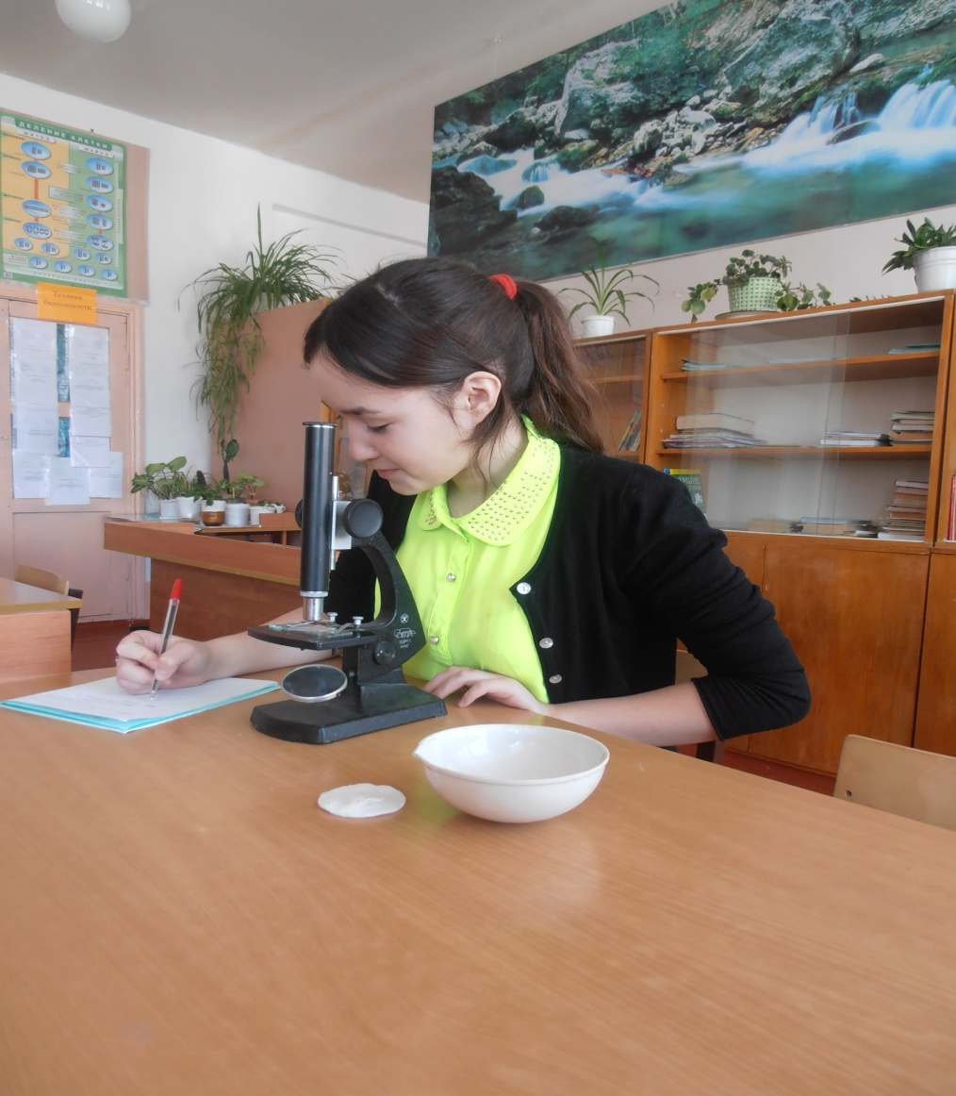
Study specks of dust

Slide 20

Collect dust at home

Slide 21
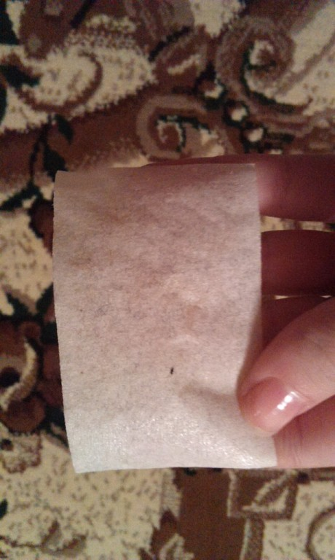
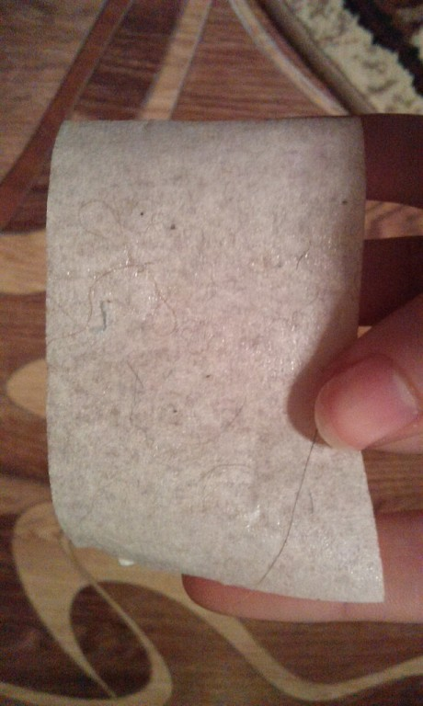
Dust from armchair and floor carpet

Slide 22
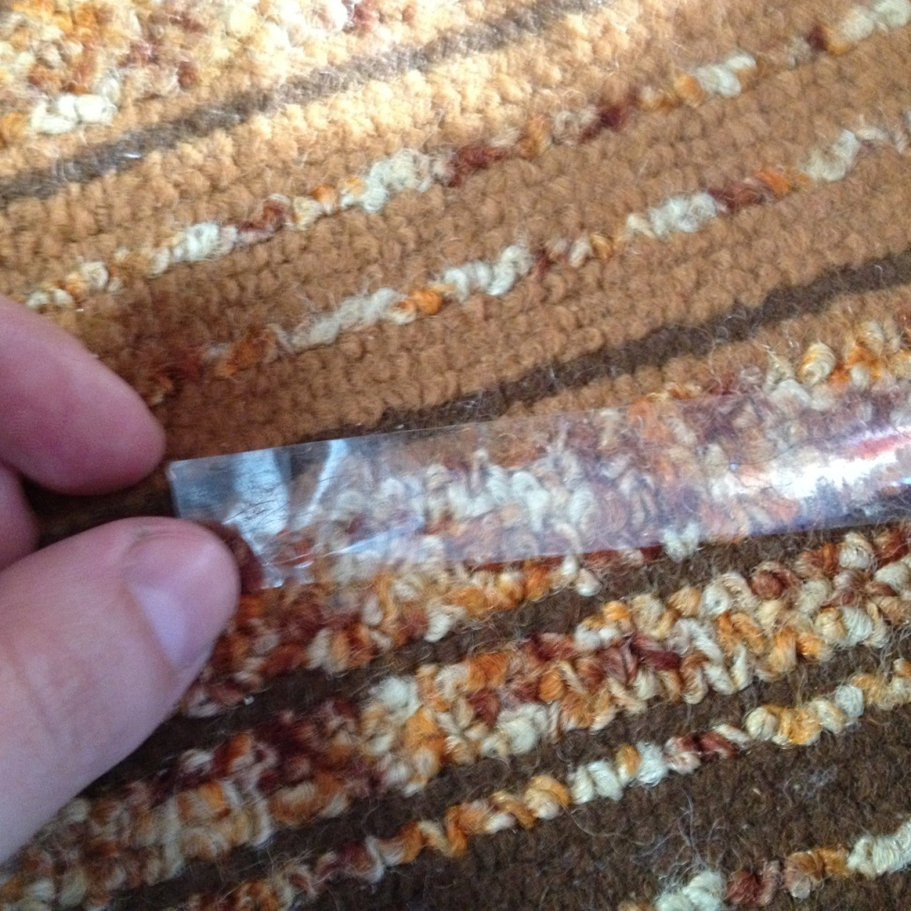
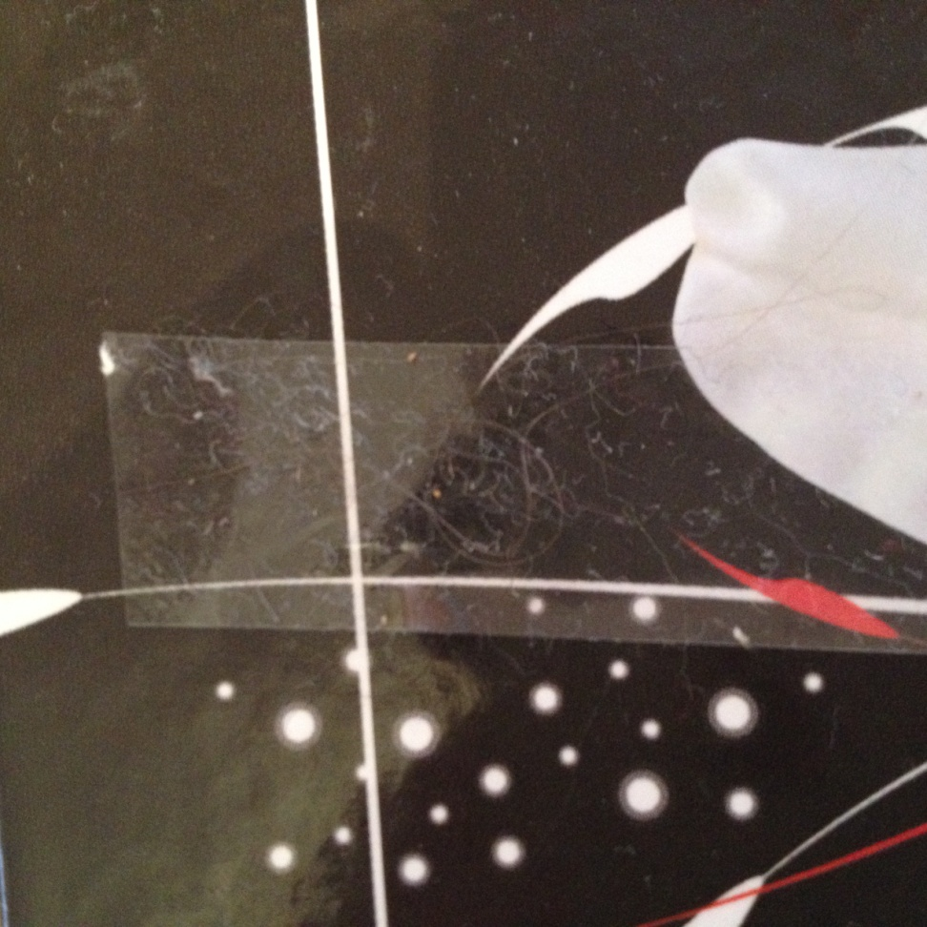
Dust on floor carpet

Slide 23
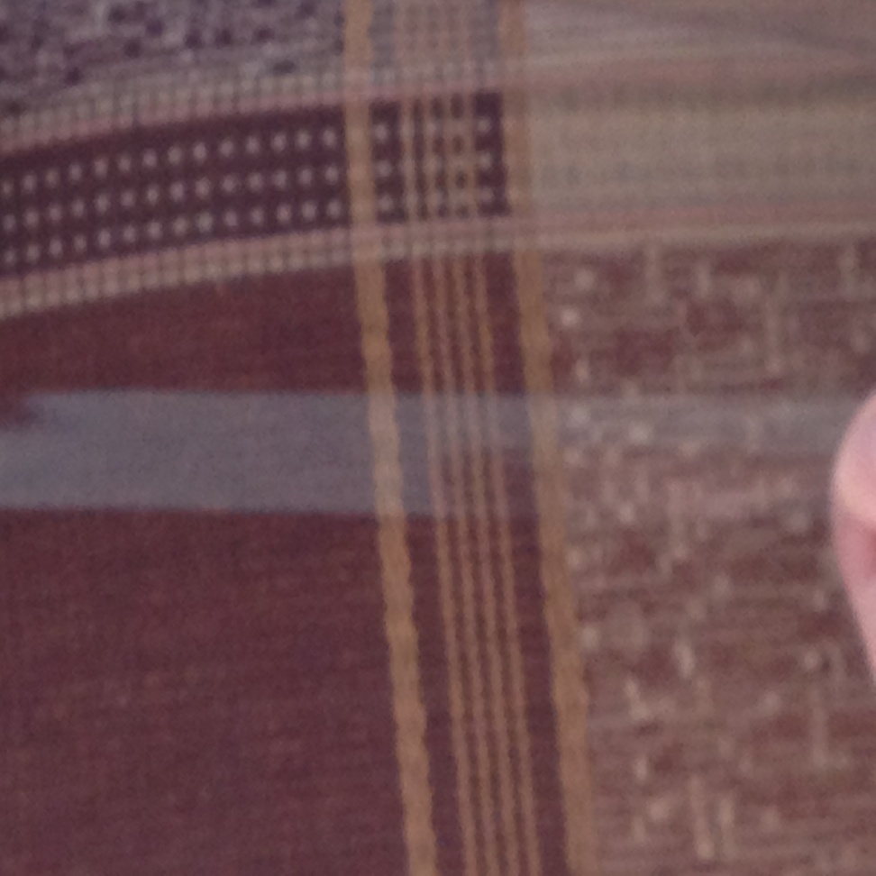
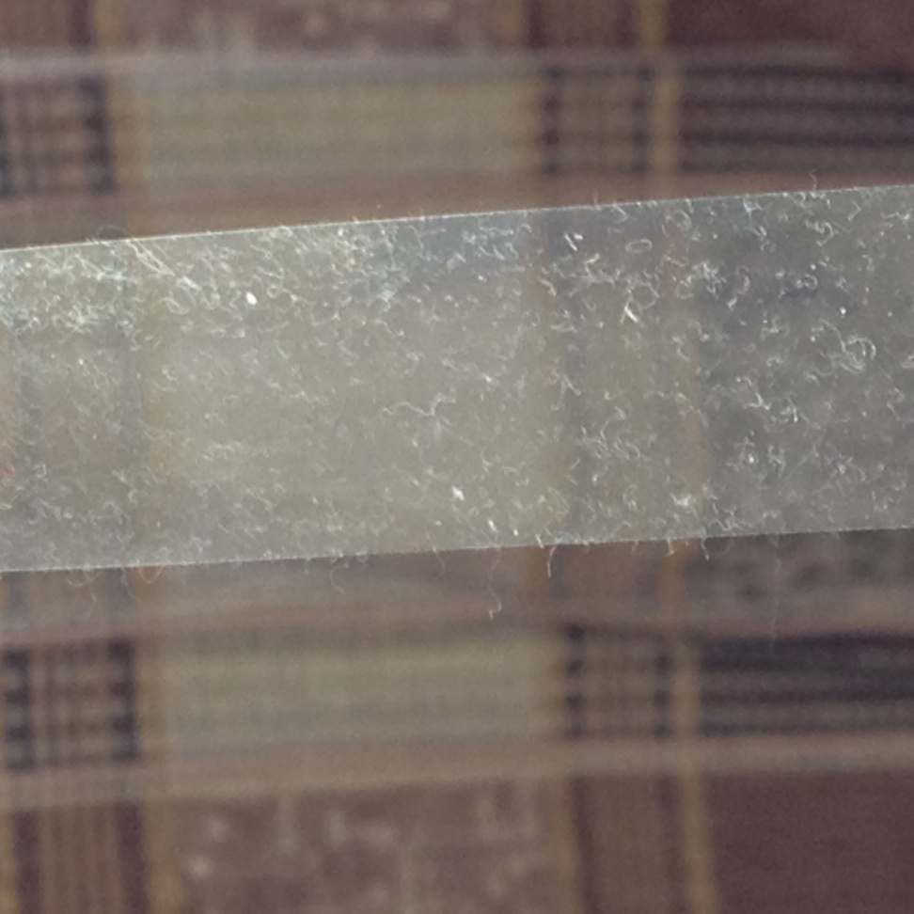
Dust on armchair

Slide 24
Results:
Most of all white dust was under the blackboard on the floor, on the cupboard, on the computer’s keyboard
In the girls’ rooms most of all dust was on the floor carpet( 4-6 days), less dust was on the window- sill on the first days after cleaning, than we could see their covering with dust
On the cupboards degree of pollution is small.

Slide 25
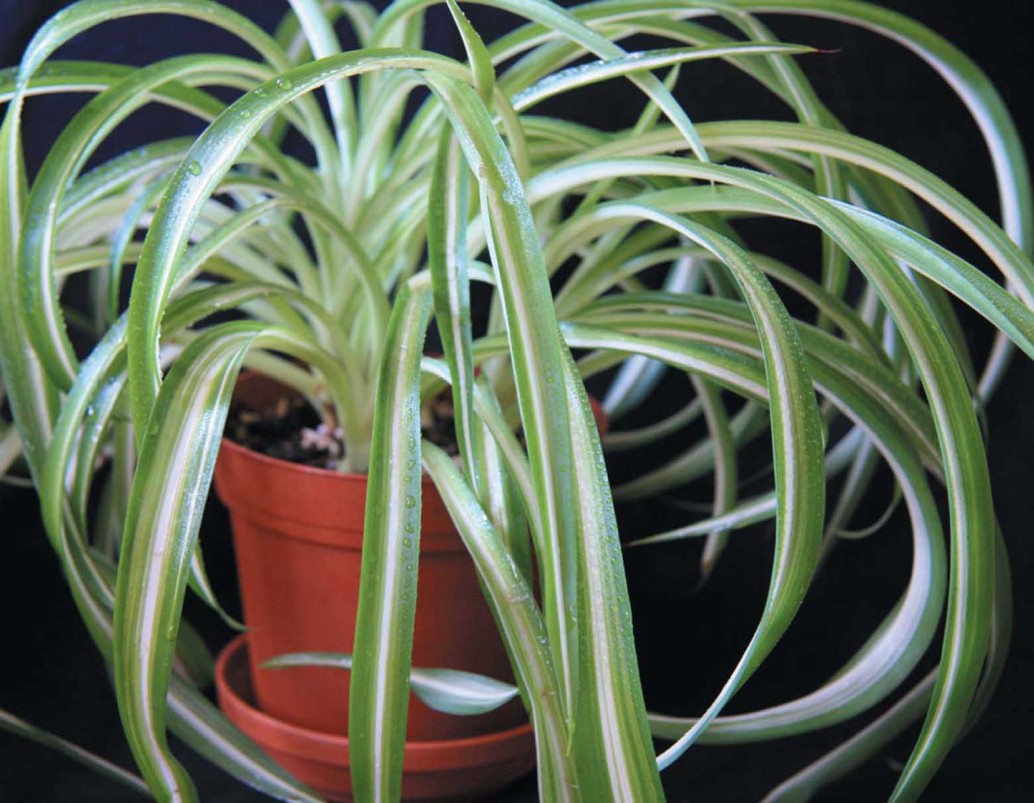
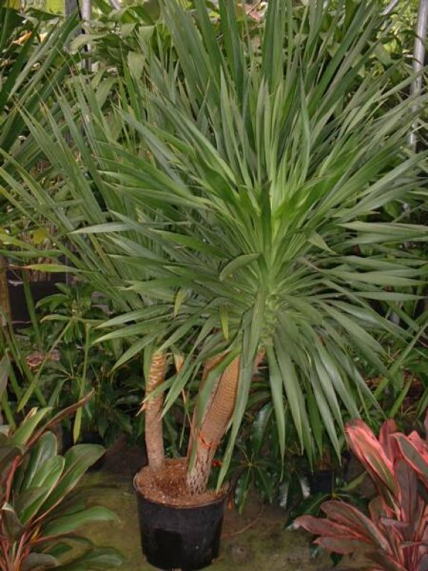
Some plants such as chlorophitum, aloe, ficus ,ivy and others can clean the air

Slide 26
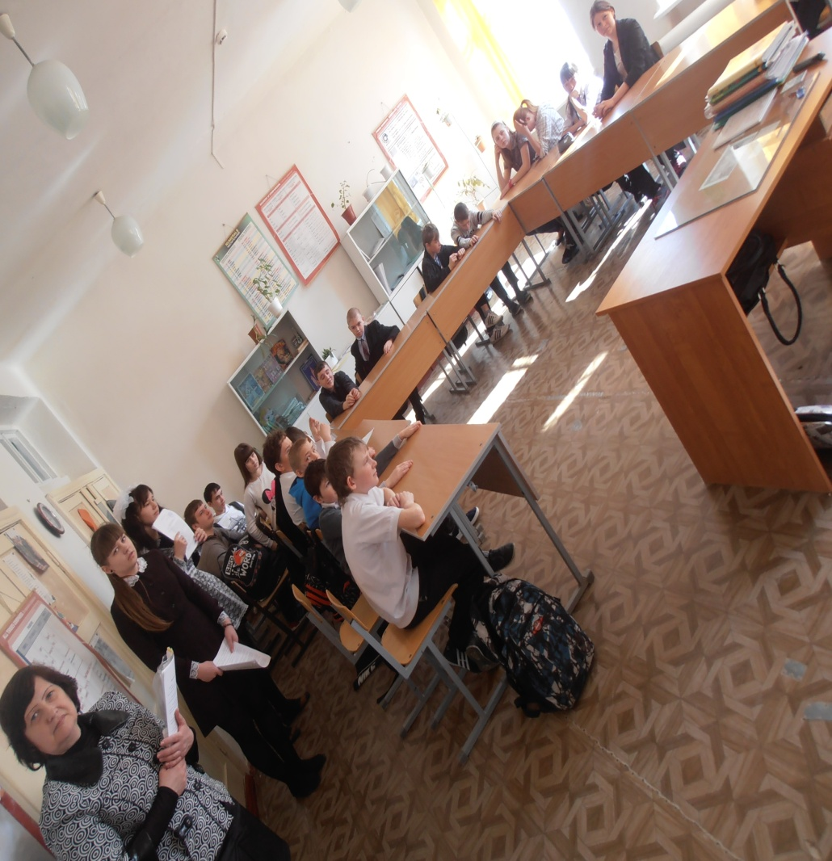
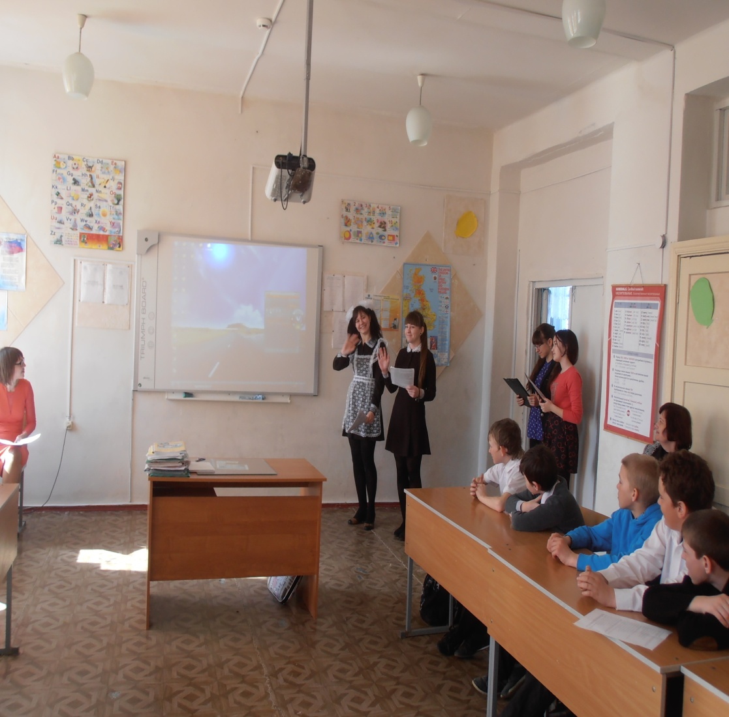
Out- of- school arrangement. Photo account

Slide 27
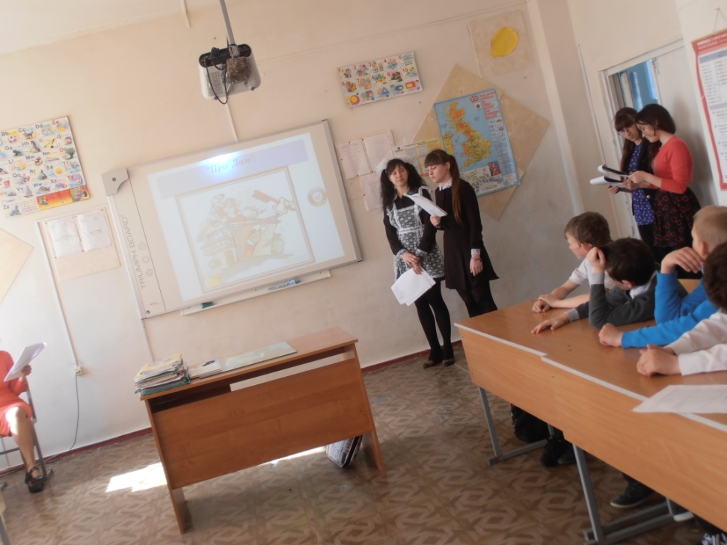
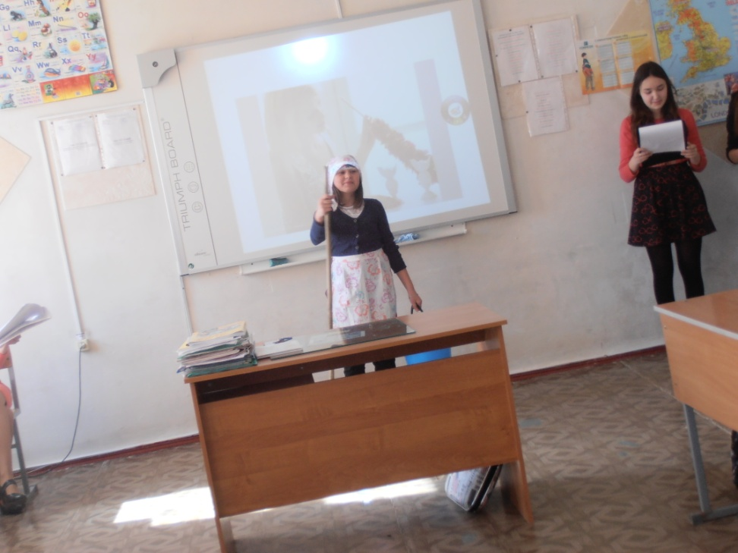

Slide 28
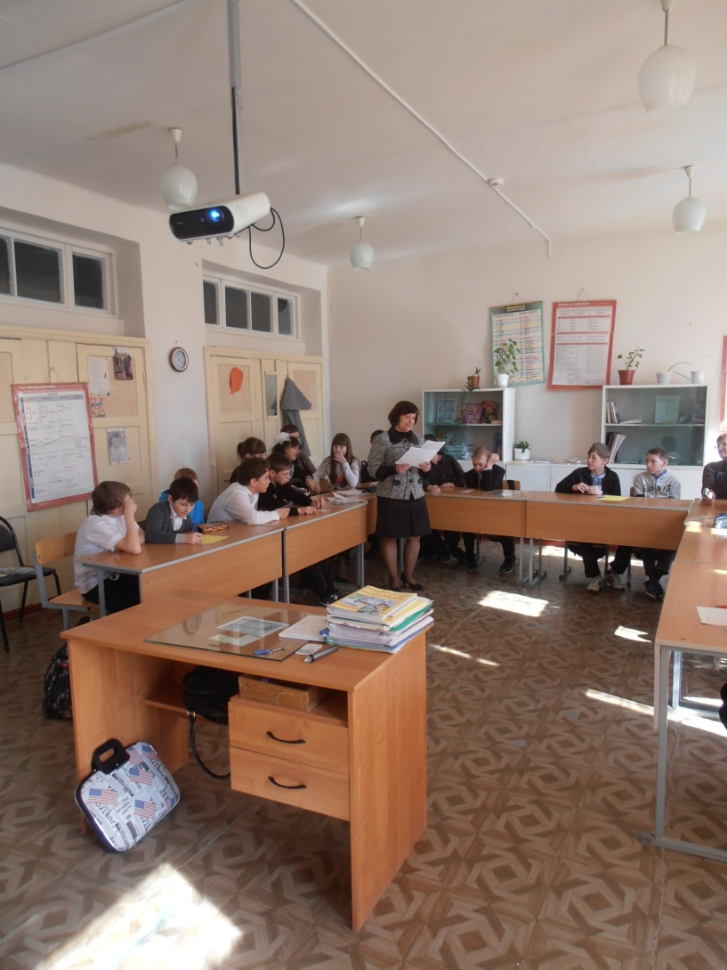
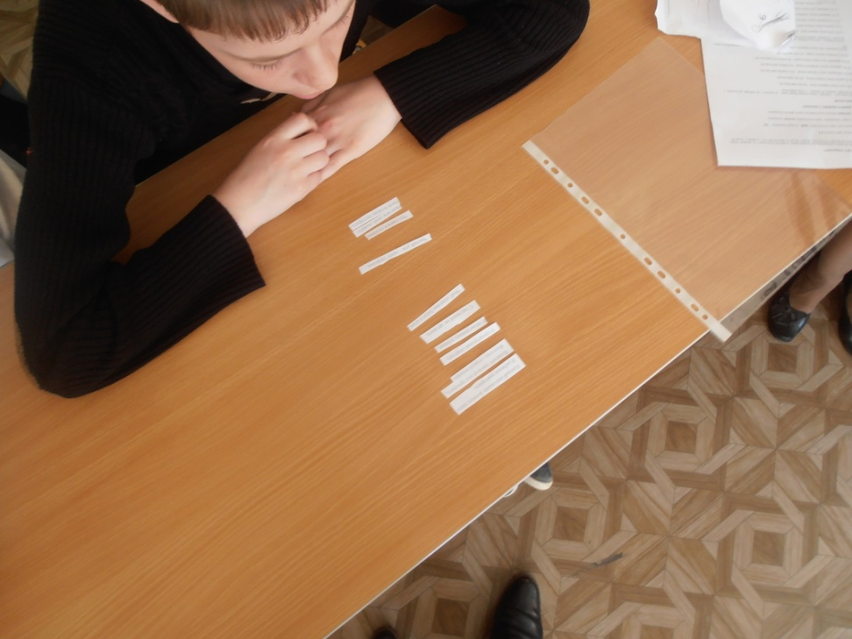

Slide 29
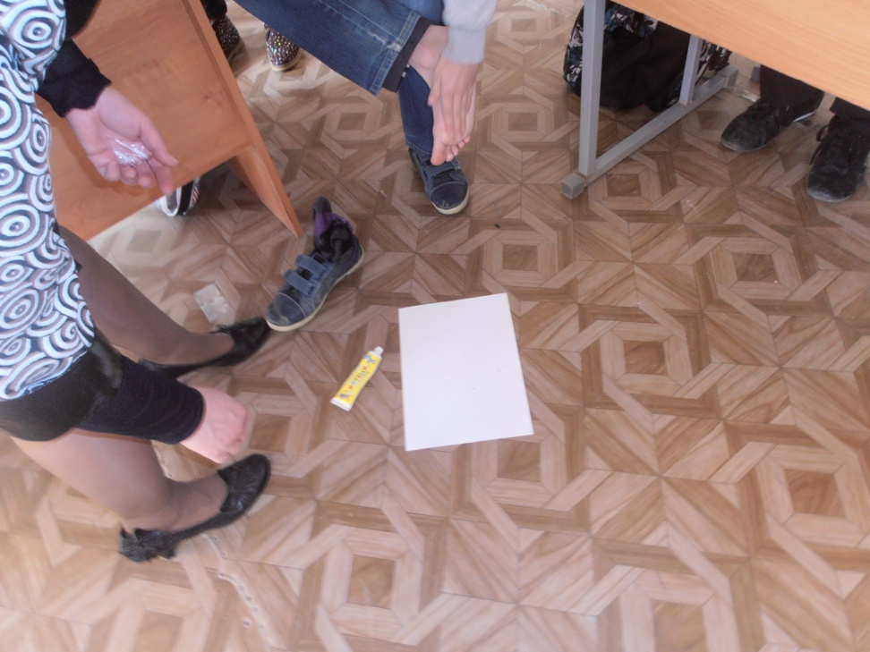
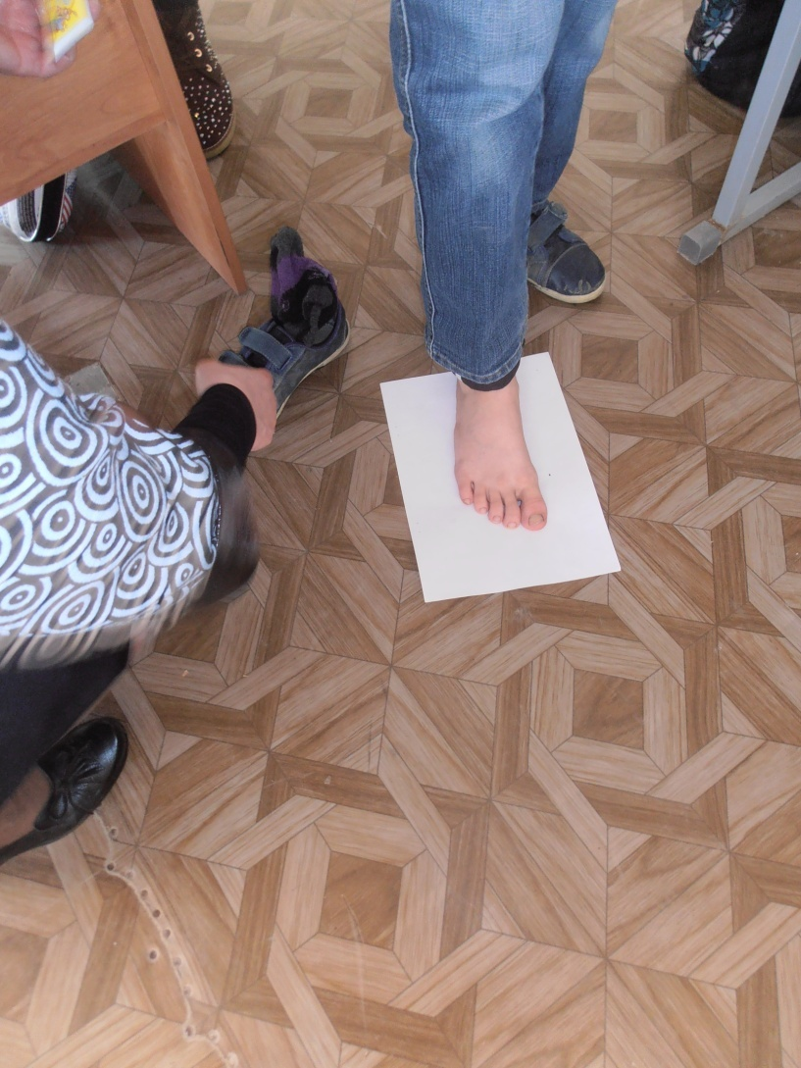

Slide 30
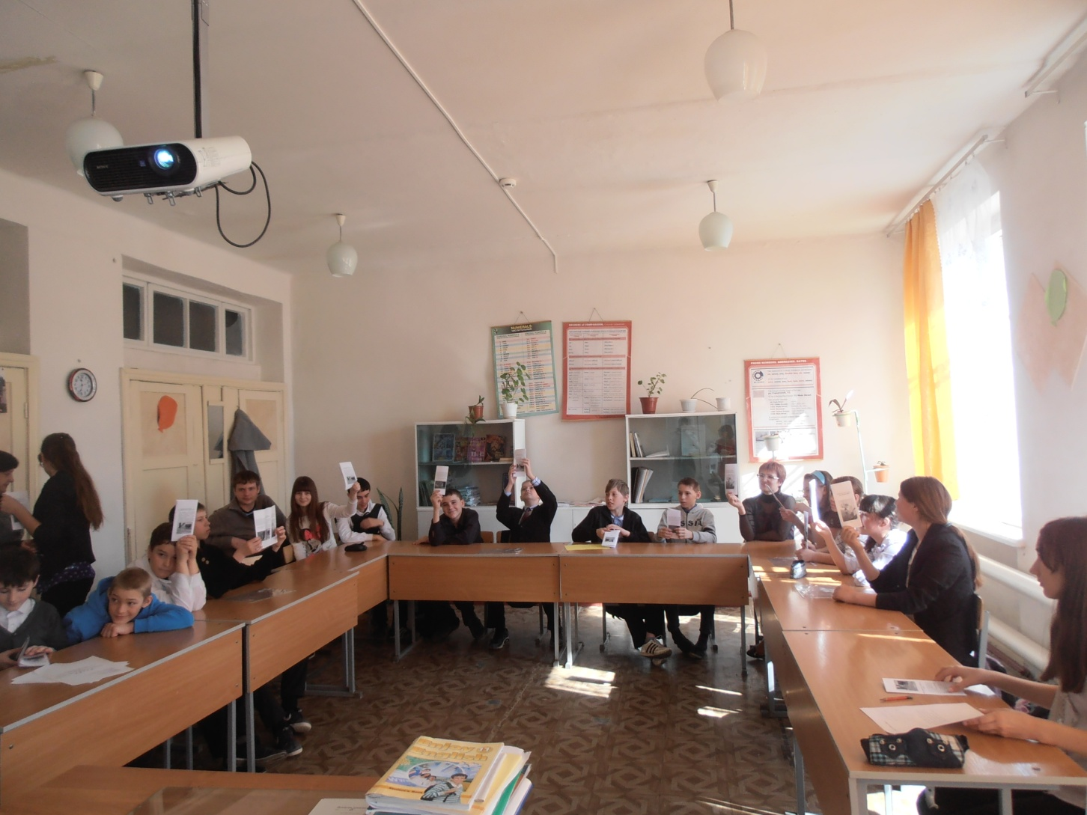

Slide 31
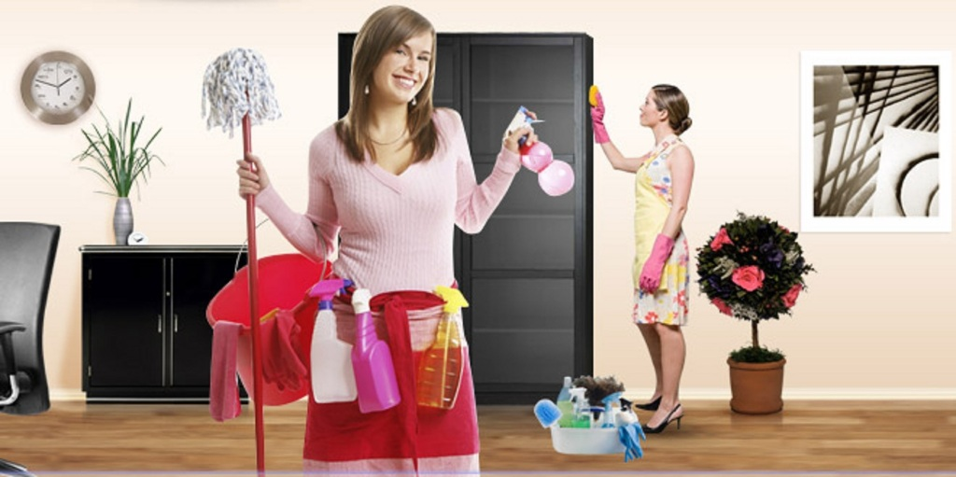
In order to lessen dust you must follow the next recomendations:

Slide 32
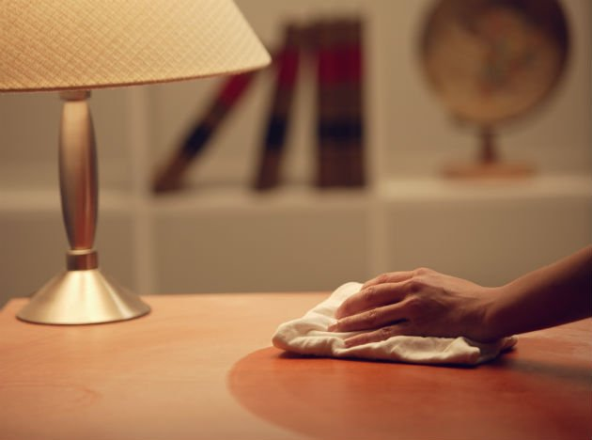
Each break you must clean the blackboard;
tidy up the classroom wet and ventilate it;
check the clearness of second shoes;
acquire more plants;
Acquire interact blackboard.

Slide 33

Be healthy! Thank you for your attention!

